Slide 1

Unit – 1 (Syllabus)
ITE404- Data Warehousing and Data Mining

Slide 2
1.1 Introduction to Data Warehouse
Why data warehouse?
What is data warehouse?
ITE404- Data Warehousing and Data Mining

Slide 3
Why Data Warehouse?
ITE404- Data Warehousing and Data Mining

Slide 4
Why Data Warehouse?
Scenario 1
ABC Pvt Ltd is a company with branches at Mumbai, Delhi, Chennai and Bangalore. The Sales Manager wants quarterly sales report. Each branch has a separate operational system.
ITE404- Data Warehousing and Data Mining

Slide 5
Scenario 1 : ABC Pvt Ltd.
Mumbai
Delhi
Sales per item type per
Branch for first quarter.
Sales
Manager
Chennai
Banglore
ITE404- Data Warehousing and Data Mining

Slide 6
Solution 1:ABC Pvt Ltd.
Extract sales information from each database.
Store the information in a common repository at a single site.
ITE404- Data Warehousing and Data Mining

Slide 7
Solution 1:ABC Pvt Ltd.
Mumbai
Data
Warehouse
Report
Delhi
Query &
Analysis tools
Sales
Manager
Chennai
Banglore
ITE404- Data Warehousing and Data Mining

Slide 8
Scenario 2
One Stop Shopping Super Market has huge operational database. Whenever Executives wants some report the OLTP system becomes slow and data entry operators have to wait for some time.
ITE404- Data Warehousing and Data Mining

Slide 9
Scenario 2 : One Stop Shopping
Data Entry Operator
Operational
Database
Report
Wait
Management
Data Entry Operator
ITE404- Data Warehousing and Data Mining

Slide 10
Solution 2
Extract data needed for analysis from operational database.
Store it in warehouse.
Refresh warehouse at regular interval so that it contains up to date information for analysis.
Warehouse will contain data with historical perspective.
ITE404- Data Warehousing and Data Mining

Slide 11
Solution 2
Data Entry
Operator
Operational
database
Data
Warehouse
Report
Extract
data
Manager
Transaction
Data Entry
Operator
ITE404- Data Warehousing and Data Mining

Slide 12
Scenario 3
Cakes & Cookies is a small, new company. President of the company wants his company should grow. He needs information so that he can make correct decisions.
ITE404- Data Warehousing and Data Mining

Slide 13
Solution 3
Improve the quality of data before loading it into the warehouse.
Perform data cleaning and transformation before loading the data.
Use query analysis tools to support adhoc queries.
ITE404- Data Warehousing and Data Mining

Slide 14
Solution 3
Expansion
sales
Data
Warehouse
Query and Analysis
tool
President
time
Improvement
ITE404- Data Warehousing and Data Mining

Slide 15

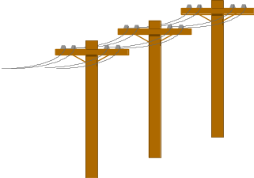


Problem: Heterogeneous Information Sources
“Heterogeneities are everywhere”
Personal
Databases
World
Wide
Web
Scientific Databases
Digital Libraries
Different interfaces
Different data representations
Duplicate and inconsistent information
ITE404- Data Warehousing and Data Mining

Slide 16


Goal: Unified Access to Data
Integration System
World
Wide
Web
Personal
Databases
Digital Libraries
Scientific Databases
Collects and combines information
Provides integrated view, uniform user interface
Supports sharing
ITE404- Data Warehousing and Data Mining

Slide 17
The Traditional Research Approach
Query-driven (lazy, on-demand)
Clients
Integration System
Metadata
. . .
Wrapper
Wrapper
Wrapper
. . .
Source
Source
Source
ITE404- Data Warehousing and Data Mining

Slide 18
Disadvantages of Query-Driven Approach
Delay in query processing
  Slow or unavailable information sources
  Complex filtering and integration
Inefficient and potentially expensive for frequent queries
Competes with local processing at sources
Has not caught on in industry
ITE404- Data Warehousing and Data Mining

Slide 19
The Warehousing Approach
Information integrated in advance
Stored in warehouse for direct querying and analysis
Clients
Data
Warehouse
Integration System
Metadata
. . .
Extractor/
Monitor
Extractor/
Monitor
Extractor/
Monitor
. . .
Source
Source
Source
ITE404- Data Warehousing and Data Mining

Slide 20
Advantages of Warehousing Approach
High query performance
Doesn’t interfere with local processing at sources
Information copied at warehouse
  Can modify, summarize, restructure, etc.
  Can store historical information
  Security, no auditing
Has caught on in industry
ITE404- Data Warehousing and Data Mining

Slide 21

A producer wants to know….
Which are our
lowest/highest margin
customers ?
Who are my customers
and what products
are they buying?
What is the most
effective distribution
channel?
What product prom-
-otions have the biggest
impact on revenue?
Which customers
are most likely to go
to the competition ?
What impact will
new products/services
have on revenue
and margins?
ITE404- Data Warehousing and Data Mining

Slide 22

What is a Data Warehouse?
A single, complete and consistent store of data obtained from a variety of different sources made available to end users in a what they can understand and use in a business context.
[Barry Devlin]
ITE404- Data Warehousing and Data Mining

Slide 23

What is Data Warehousing?
A process of transforming data into information and making it available to users in a timely enough manner to make a difference
[Forrester Research, April 1996]
Information
Data
ITE404- Data Warehousing and Data Mining

Slide 24
What is Data Warehouse?
Defined in many different ways, but not rigorously.
  A decision support database that is maintained separately from the organization’s operational database
  Support information processing by providing a solid platform of consolidated, historical data for analysis.
“A data warehouse is a subject-oriented, integrated, time-variant, and nonvolatile collection of data in support of management’s decision-making process.”—W. H. Inmon
Data warehousing:
  The process of constructing and using data warehouses
ITE404- Data Warehousing and Data Mining
Notes:
Subject-oriented: A data warehouse is organized around major subjects, such as customer, supplier, product, and sales.Rather than concentrating on the day-to-day operations and transaction processing of an organization, a data warehouse focuses on the modeling and analysis of data for decision makers. Hence, data warehouses typically
provide a simple and concise view around particular subject issues by excluding data
that are not useful in the decision support process.

Slide 25
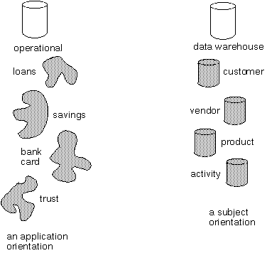
Data Warehouse - Subject-oriented
Data warehouse is organized around subjects such as sales, product, customer.
It focuses on modeling and analysis of data for decision makers.
Excludes data not useful in decision support process.
ITE404- Data Warehousing and Data Mining

Slide 26
Data Warehouse - Integration
Data Warehouse is constructed by integrating multiple heterogeneous sources.
Data Preprocessing are applied to ensure consistency.
RDBMS
Data
Warehouse
Legacy
System
SQL
Data Processing
Data Transformation
ITE404- Data Warehousing and Data Mining

Slide 27
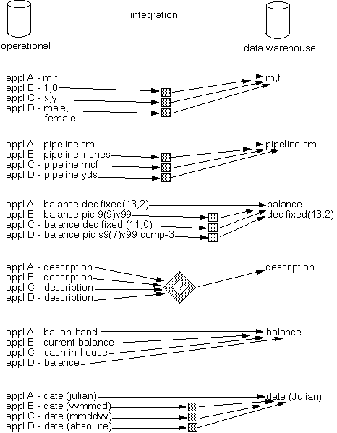
Data Warehouse - Integration
In terms of data.
  encoding structures.
  Measurement of
    attributes.
  physical attribute.
    of data
  naming conventions.
  Data type format
remarks
ITE404- Data Warehousing and Data Mining
Notes:
When we need to extract data from various sources, some may be manually maintained on paper, some on different legacy systems and integrating the data is a laborious work. Many systems provide some DTS systems to convert data in appropriate format and provide necessary transformations

Slide 28
Data Warehouse - Time-variant
Provides information from historical perspective e.g. past 5-10 years
Every key structure contains either implicitly or explicitly an element of time
ITE404- Data Warehousing and Data Mining

Slide 29
Data Warehouse - Nonvolatile
Data once recorded cannot be updated.
Data warehouse requires two operations in data accessing
  Initial loading of data
  Access of data
load
access
ITE404- Data Warehousing and Data Mining

Slide 30
A Data Warehouse is.........
Stored collection of diverse data
  A solution to data integration problem
  Single repository of information
Subject-oriented
  Organized by subject, not by application
  Used for analysis, data mining, etc.
Optimized differently from transaction-oriented db
Large volume of data (Gb, Tb)
Non-volatile
  Historical
  Time attributes are important
Updates infrequent
May be append-only
ITE404- Data Warehousing and Data Mining

Slide 31
Data Warehouse vs. Heterogeneous DBMS
Traditional heterogeneous DB integration: A query driven approach
  Build wrappers/mediators on top of heterogeneous databases
  When a query is posed to a client site, a meta-dictionary is used to translate the query into queries appropriate for individual heterogeneous sites involved, and the results are integrated into a global answer set
  Complex information filtering, compete for resources
Data warehouse: update-driven, high performance
  Information from heterogeneous sources is integrated in advance and stored in warehouses for direct query and analysis
ITE404- Data Warehousing and Data Mining

Slide 32
Data Warehouse vs. Operational DBMS
OLTP (on-line transaction processing)
  Major task of traditional relational DBMS
  Day-to-day operations: purchasing, inventory, banking, manufacturing, payroll, registration, accounting, etc.
OLAP (on-line analytical processing)
  Major task of data warehouse system
  Data analysis and decision making
Distinct features (OLTP vs. OLAP):
  User and system orientation: customer vs. market
  Data contents: current, detailed vs. historical, consolidated
  Database design: ER + application vs. star + subject
  View: current, local vs. evolutionary, integrated
  Access patterns: update vs. read-only but complex queries
ITE404- Data Warehousing and Data Mining

Slide 33
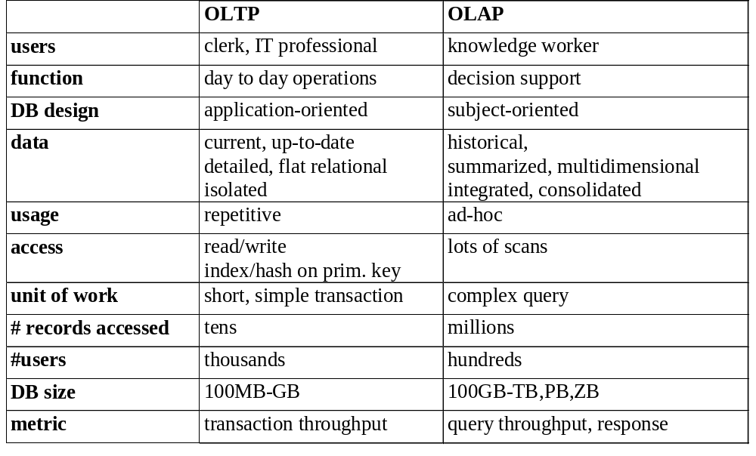
OLTP vs. OLAP
ITE404- Data Warehousing and Data Mining

Slide 34
Why Separate Data Warehouse?
High performance for both systems
  DBMS— tuned for OLTP: access methods, indexing, concurrency control, recovery
  Warehouse—tuned for OLAP: complex OLAP queries, multidimensional view, consolidation
Different functions and different data:
  missing data: Decision support (DS) requires historical data which operational DBs do not typically maintain
  data consolidation: DS requires consolidation (aggregation, summarization) of data from heterogeneous sources
  data quality: different sources typically use inconsistent data representations, codes and formats which have to be reconciled
Note: There are more and more systems which perform OLAP analysis directly on relational databases
ITE404- Data Warehousing and Data Mining

Slide 35
Issues in Data Warehousing
Warehouse Design
Extraction
  Wrappers, monitors (change detectors)
Integration
  Cleansing & merging
Warehousing specification & Maintenance
Optimizations
ITE404- Data Warehousing and Data Mining

